Slide 1

EE4202 Database Systems
WORKSHOP 2
DATABASE
IMPLEMENTATION

Slide 2
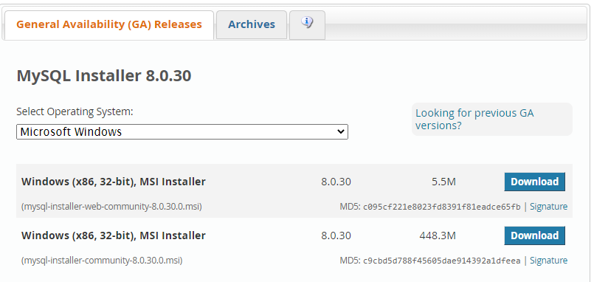
INSTALLING MySQL
https://www.mysql.com/downloads/
MySQL Community (GPL) Downloads » MySQL community server
Select the second one – complete package
https://www.youtube.com/watch?v=WuBcTJnIuzo

Slide 3
MySQL command line Client
- To interact with MySQL databases.
mysql> show databases; - show all default/available databases
mysql> use world; - access the ‘world’ database
mysql> show tables; - show all the table inside the database ‘world’
- MySQL Workbench – to connect with the databases
- Database -> connect to database

Slide 4
DATABASE CREATION
Create the following database schema and populate it as given using MySQL.
DEPARTMENT
EMPLOYEE
Dept_ID | Dept_Head
EIE | Menuka
MME | Ranil
CEE | Lasitha
Empl_ID | Dept_ID | Area | Designation
EE001 | EIE | Software | Lecturer
EE002 | EIE | Communication | Senior Lecturer
MM007 | MME | Automobile | Lecturer
MM001 | MME | Manufacturing | Senior Lecturer
CE001 | CEE | NULL | Lab Attendant
CE003 | CEE | Structural | Lecturer
CE007 | CEE | Environment | Lecturer
EE005 | EIE | NULL | Labourer

Slide 5
Referential Integrity Constraint (1:many)
WORKS_IN
n
1
DEPARTMENT
EMPLOYEE
DEPARTMENT
EMPLOYEE
Dept_ID | Dept_Head
EIE | Menuka
MME | Ranil
CEE | Lasitha
Empl_ID | Dept_ID | Area | Designation
EE001 | EIE | Software | Lecturer
EE002 | EIE | Communication | Senior Lecturer
MM007 | MME | Automobile | Lecturer
MM001 | MME | Manufacturing | Senior Lecturer
CE001 | CEE | NULL | Lab Attendant
CE003 | CEE | Structural | Lecturer
CE007 | CEE | Environment | Lecturer
EE005 | EIE | NULL | Labourer

Slide 6
Referential Integrity Constraint (many:many)
WORKS_ON
n
m
EMPLOYEE
PROJECT
EMPLOYEE
Empl_ID | Dept_ID | Area | Designation
EE001 | EIE | Software | Lecturer
EE002 | EIE | Communication | Senior Lecturer
MM007 | MME | Automobile | Lecturer
MM001 | MME | Manufacturing | Senior Lecturer
CE001 | CEE | NULL | Lab Attendant
CE003 | CEE | Structural | Lecturer
CE007 | CEE | Environment | Lecturer
EE005 | EIE | NULL | Labourer
PROJECT
Employee_ID | Project
EE001 | Prj_1
EE001 | Prj_2
CE008 | Prj_1

